Slide 1
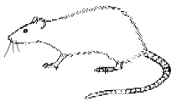
What caused the Black Death?
LO: To understand what Medieval People believed caused the Black Death.
© A. Hughes (MsHughesTeaches), 2014

Slide 2

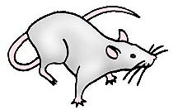
Starter
THINK - PAIR - SHARE
10 minutes
What do we know caused the Black Death?
Why do we know what caused the Black Death?
© A. Hughes (MsHughesTeaches), 2014

Slide 3
Identify what Medieval people believed caused the Black Death and why.
Describe the ways medieval people believed the Black Death was Spread and give some examples.
Explain what Medieval people believed caused the Black Death and explain some of their methods to avoid it.
Do all of the above and decide if any of the advice would work giving REASONS.
© A. Hughes (MsHughesTeaches), 2014

Slide 4

Know nothing
Know some
Class Expert!
© A. Hughes (MsHughesTeaches), 2014

Slide 5
Remember!
People in Medieval times did not know that fleas caused the Black Death. This meant that they made up their own ideas about where it came from.
© A. Hughes (MsHughesTeaches), 2014

Slide 6

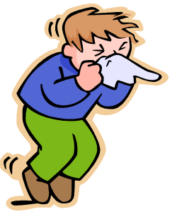
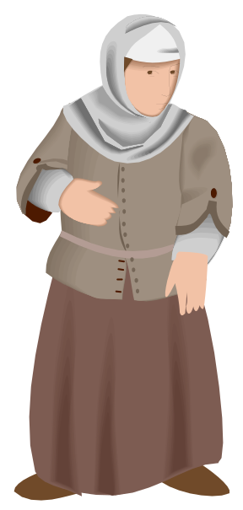
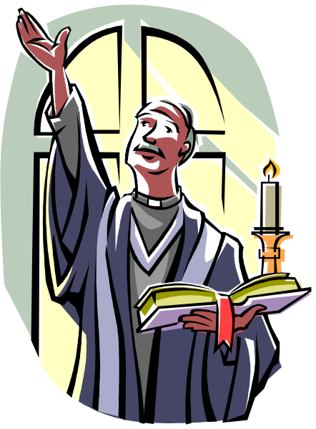
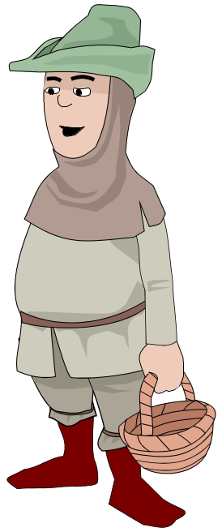
What did people think caused the Black Death?
Pooey whiff!
© A. Hughes (MsHughesTeaches), 2014

Slide 7
These different people would have different ways to avoid the Black Death.
“You must not go near a person with the Black Death.”
“We must bury the clothes of people with the Black Death.”
“We must burn the dead people’s clothes.”
“We must pray everyday and night.”
“You must carry a bunch of flowers to your nose.”
“We must beat ourselves to show we are sorry for our sins.”
“You should run away and leave everyone behind.”
“You must wear a mask made of thick cloth.”
“We must ask for help from the Priest.”
© A. Hughes (MsHughesTeaches), 2014

Slide 8
Know nothing
Know some
Class Expert!
© A. Hughes (MsHughesTeaches), 2014

Slide 9
Main Task!
20 minutes
Look at the bullet points on your sheet. What would each of these people say?
I think the Black Death is caused by Bad Smells.
So…
I think is a punishment from God. So…
I think it is passed from sick people. So…
© A. Hughes (MsHughesTeaches), 2014

Slide 10
Plenary
Look again at the advice.
Do you think any of these people’s ideas would work?
Choose two that you think would work and write down why.
Use the word because.
© A. Hughes (MsHughesTeaches), 2014

Slide 11

Identify what Medieval people believed caused the Black Death and why.
Describe the ways medieval people believed the Black Death was Spread and give some examples.
Explain what Medieval people believed caused the Black Death and explain some of their methods to avoid it.
Do all of the above and decide if any of the advice would work giving REASONS.
© A. Hughes (MsHughesTeaches), 2014

Slide 12
Know nothing
Know some
Class Expert!
© A. Hughes (MsHughesTeaches), 2014

